Slide 1
Transmission Media

Slide 2
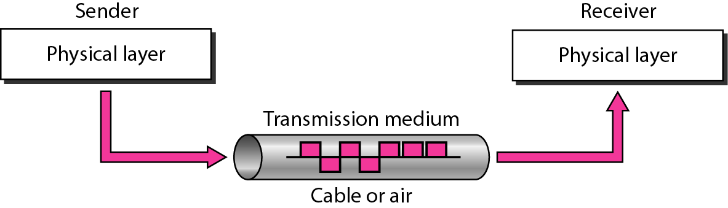
Figure 7.1 Transmission medium and physical layer [1]

Slide 3
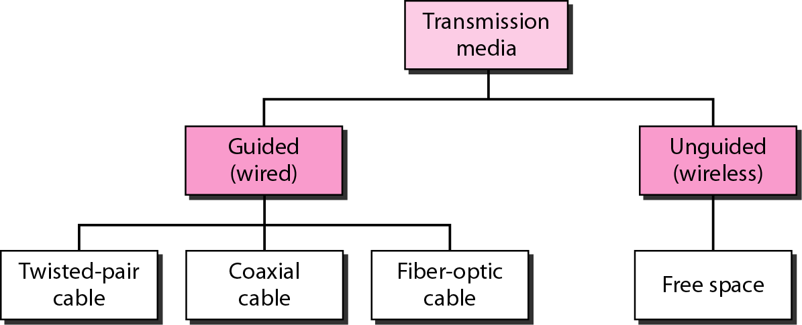
Figure 7.2 Classes of transmission media [1]

Slide 4
7-1 GUIDED MEDIA
Guided media, which are those that provide a conduit from one device to another, include twisted-pair cable, coaxial cable, and fiber-optic cable.
Topics discussed in this section:
Twisted-Pair Cable Coaxial Cable Fiber-Optic Cable

Slide 5

Figure 7.3 Twisted-pair cable [1]

Slide 6
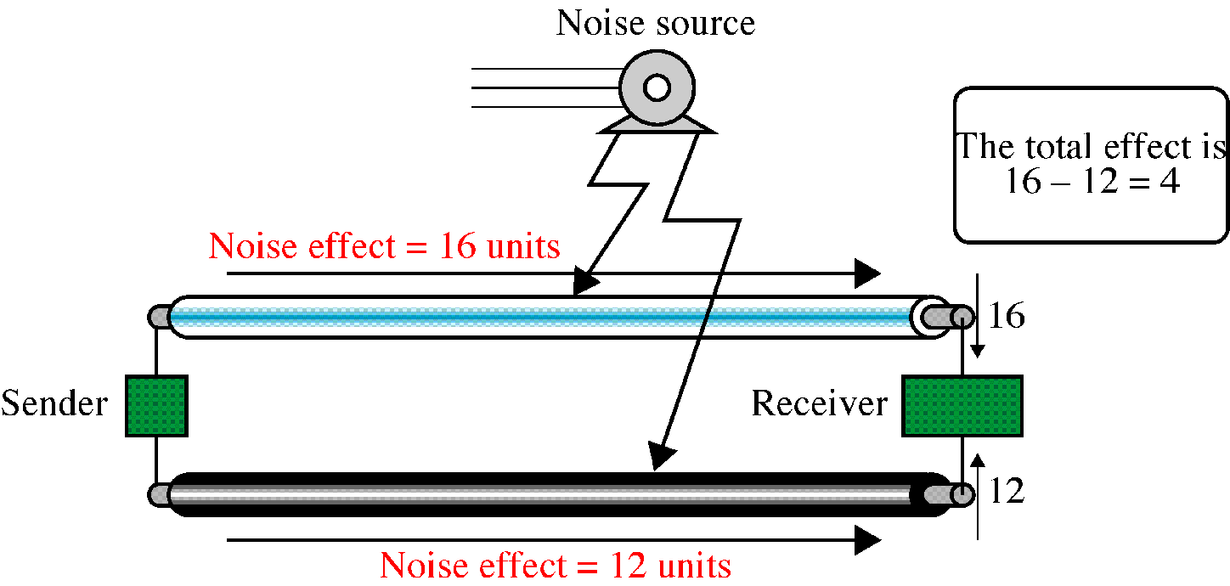

Slide 7
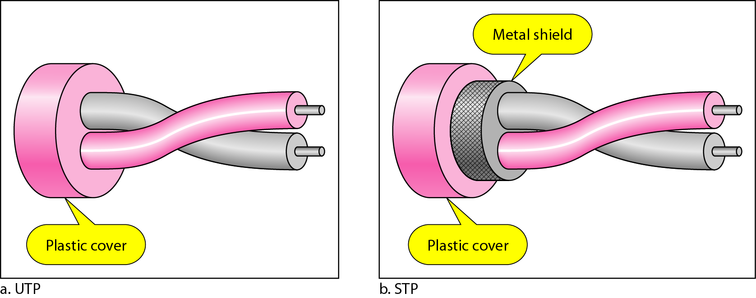
Figure 7.4 UTP and STP cables [1]

Slide 8
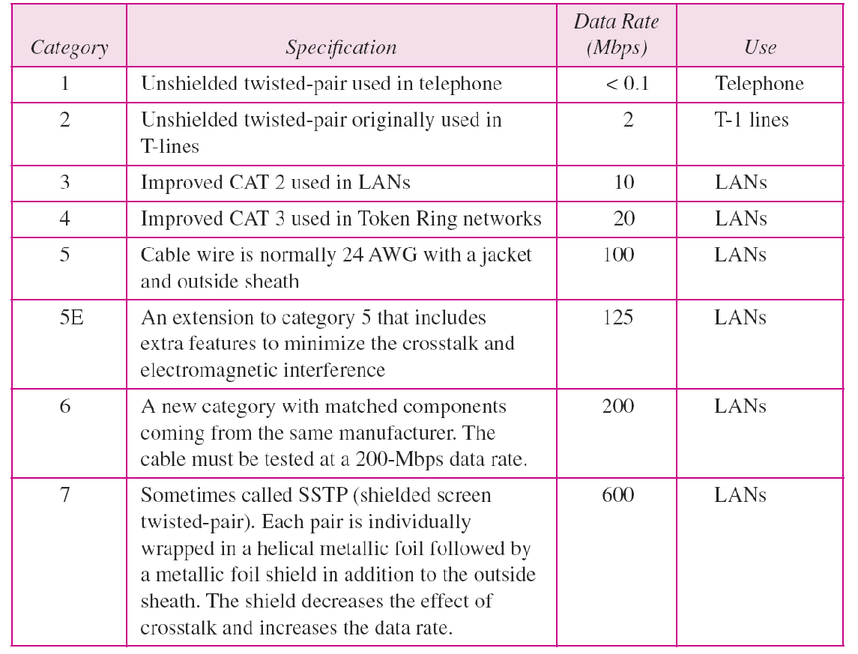
Table 7.1 Categories of unshielded twisted-pair cables [1]

Slide 9
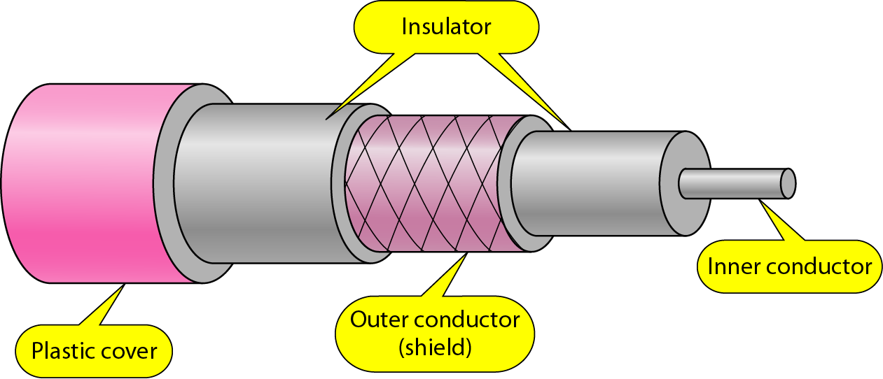
Figure 7.7 Coaxial cable [1]

Slide 10
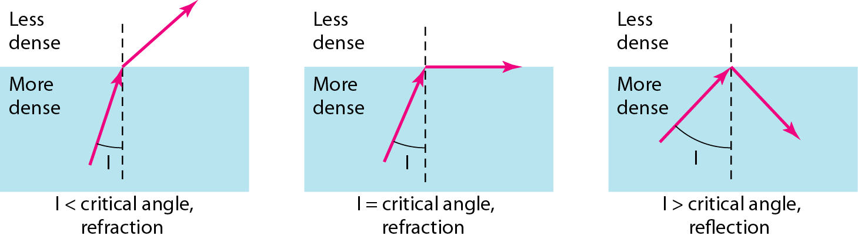
Figure 7.10 Bending of light ray [1]

Slide 11
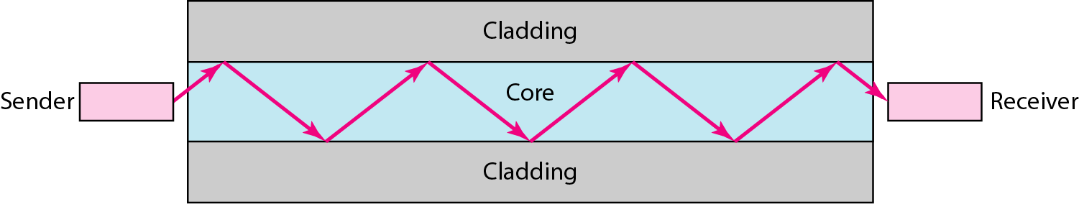
Figure 7.11 Optical fiber [1]

Slide 12
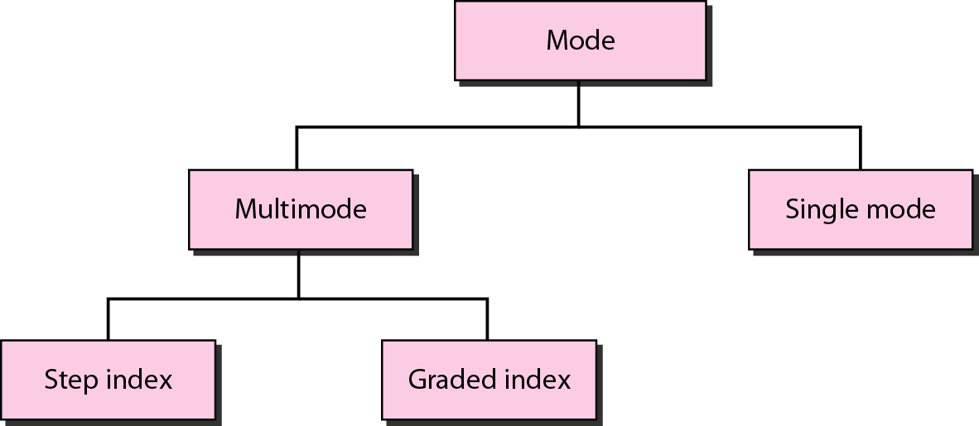
Figure 7.12 Propagation modes [1]

Slide 13
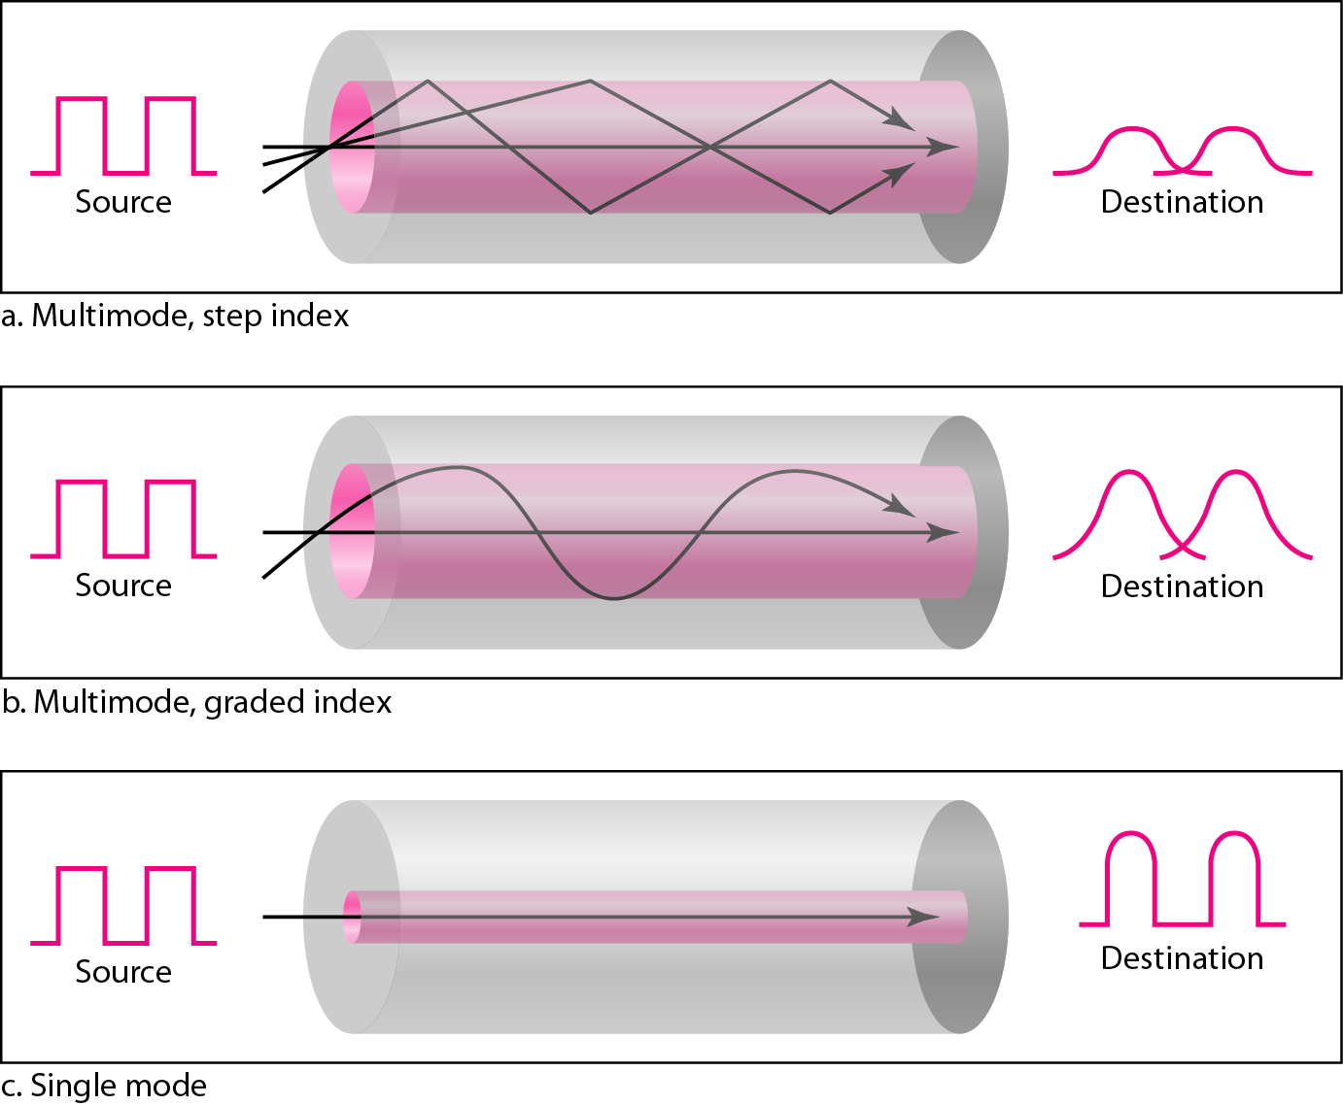
Figure 7.13 Modes [1]

Slide 14
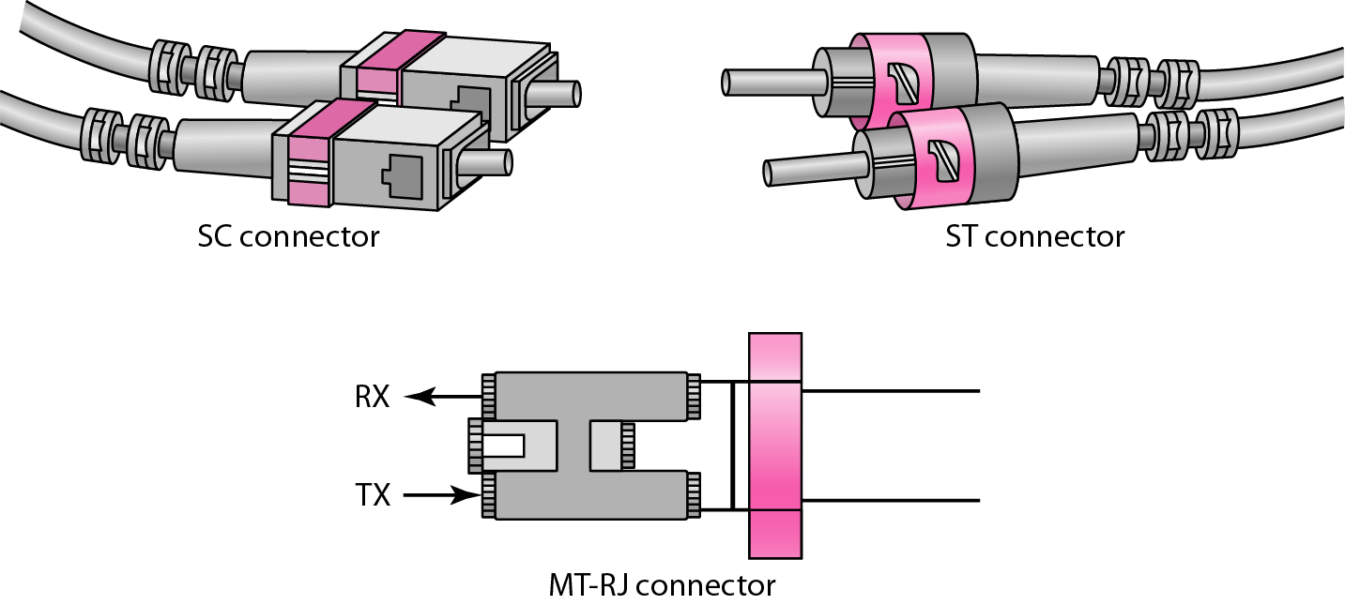
Figure 7.15 Fiber-optic cable connectors [1]

Slide 15
7-2 UNGUIDED MEDIA: WIRELESS
Unguided media transport electromagnetic waves without using a physical conductor. This type of communication is often referred to as wireless communication.
Topics discussed in this section:
Radio Waves
Microwaves
Infrared

Slide 16
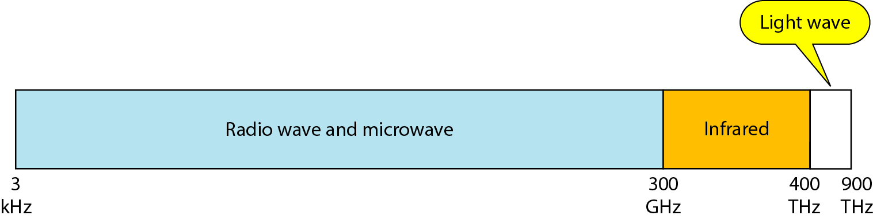
Figure 7.17 Electromagnetic spectrum for wireless communication [1]

Slide 17
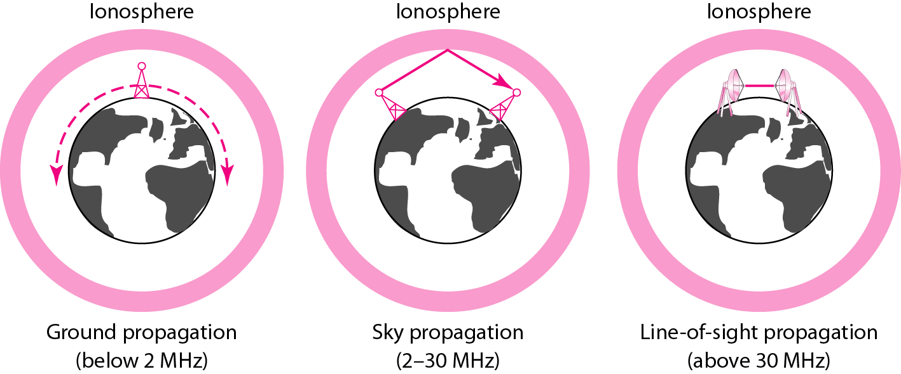
Figure 7.18 Propagation methods [1]

Slide 18
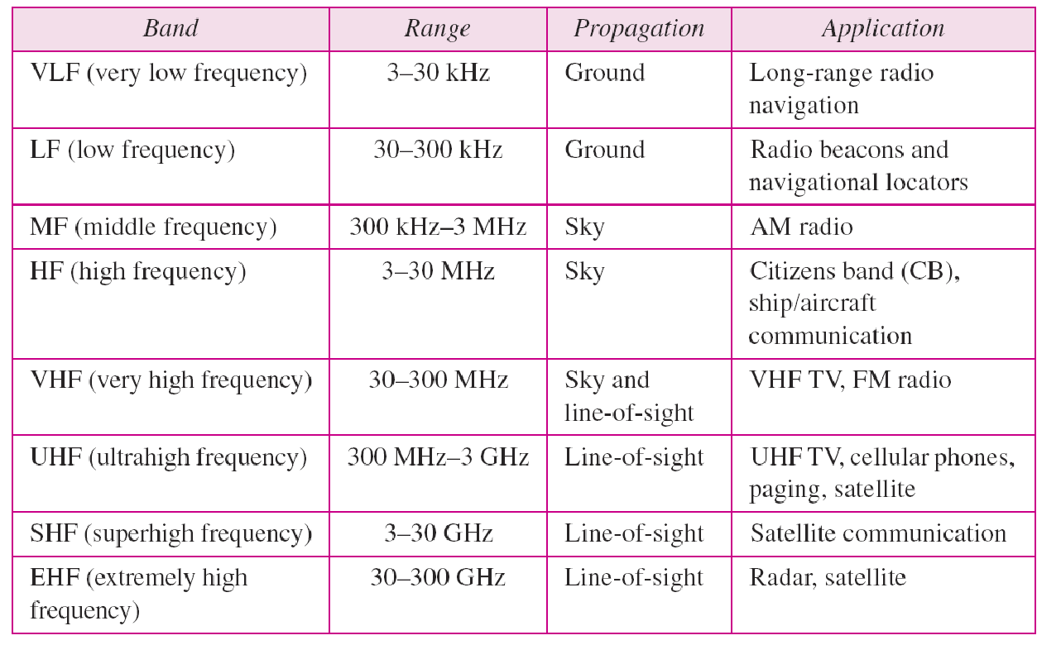
Table 7.4 Bands

Slide 19
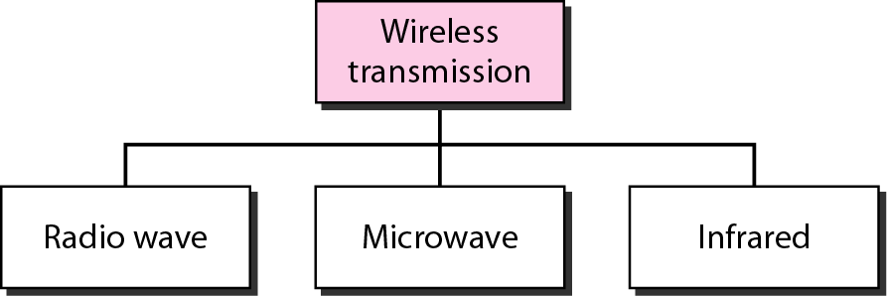
Figure 7.19 Wireless transmission waves [1]

Slide 20
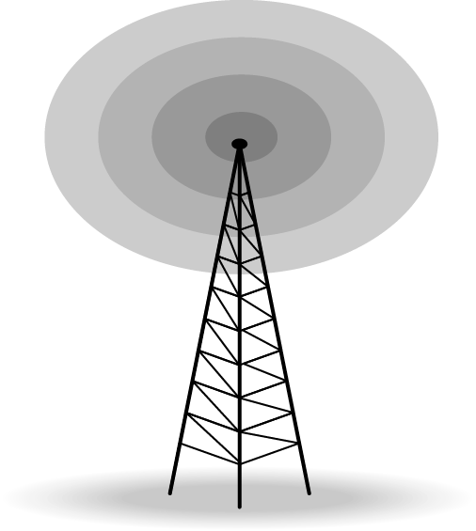
Figure 7.20 Omnidirectional antenna [1]

Slide 21

Note
Radio waves are used for multicast communications, such as radio and television, and paging systems.

Slide 22
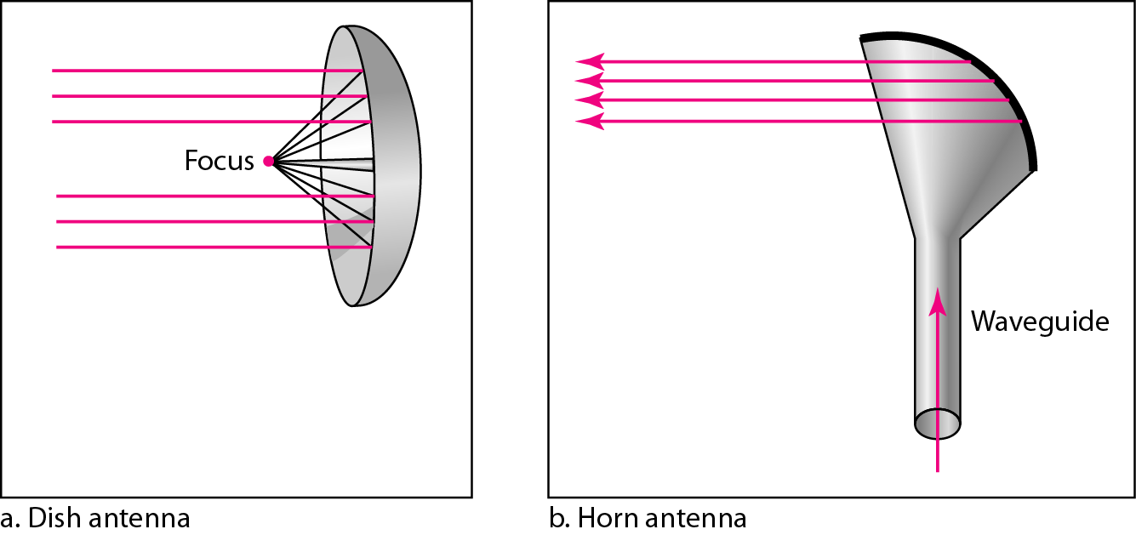
Figure 7.21 Unidirectional antennas [1]

Slide 23
Note
Microwaves are used for unicast communication such as cellular telephones, satellite networks, and wireless LANs.

Slide 24
Note
Infrared signals can be used for short-range communication in a closed area using line-of-sight propagation.

Slide 25
References:
Textbooks
[1] Forouzan, Behrouz A.: “Data Communications & networking”, 4th edition TataMcgraw Hill.
[2]Tanenbaum, Andrew S: “Computer networks”, 4th Edition, Pearson education.
Reference books
[3]Stallings, William : “Data and computer communications”,8th edition,Pearson
Education.
[4] Ross, Kurose,“Computer Networking: A top down Approach”, 2nd edition, Pearson
Education.
[5] Coomer,Douglas E.: “Internet working with TCP/IP” , 2 nd edition, Pearson Education
[6] Dave,” Computer Networks, Cengage Learning.
Links:
http://eti2506.elimu.net/Introduction/Books/Data%20Communications%20and%20Networking%20By%20Behrouz%20A.Forouzan.pdf

